Slide 1

Multivariate Analysis Final Project
I-k-means−+: An iterative clustering algorithm based on an enhanced version of the k-means
2019 . 06 . 10.
이은진
EunJin Lee
2019-1 Multivariate Analysis

Slide 2
Pattern Recognition 79 (2018)
402-413
I-k-means−+: An iterative clustering algorithm
based on an enhanced version of the k-means
Hassan Ismkhan
(Computer engineering, University of Bonab, Bonab, East Azerbaijian, Iran)
EunJin Lee
2019-1 Multivariate Analysis

Slide 3

Contents
Introduction
Recent works for k-means
I-k-means - +
Results of performed experiments
Conclusion
GLMs
EunJin Lee
2019-1 Multivariate Analysis
PJM WSM ISH

Slide 4
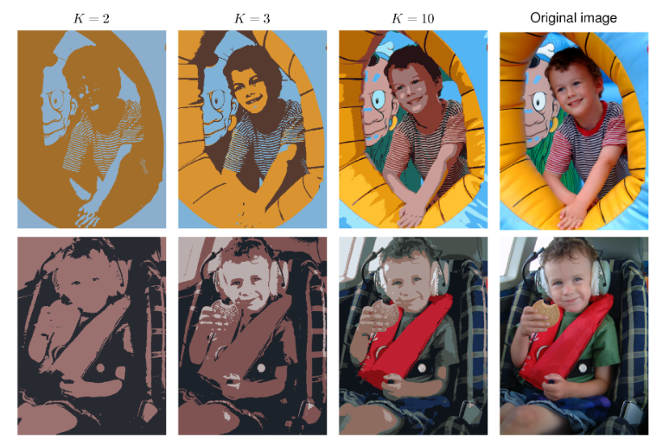
1. Introduction
Data clustering
Cover wide range of application : video processing, image processing, text analysis, bioinformatics, wireless sensor networks, analysis for web social networks, and document clustering.
Kinds of clustering : DBSCAN, CURE Chameleon, and k-MS.
GLMs
EunJin Lee
2019-1 Multivariate Analysis
PJM WSM ISH

Slide 5
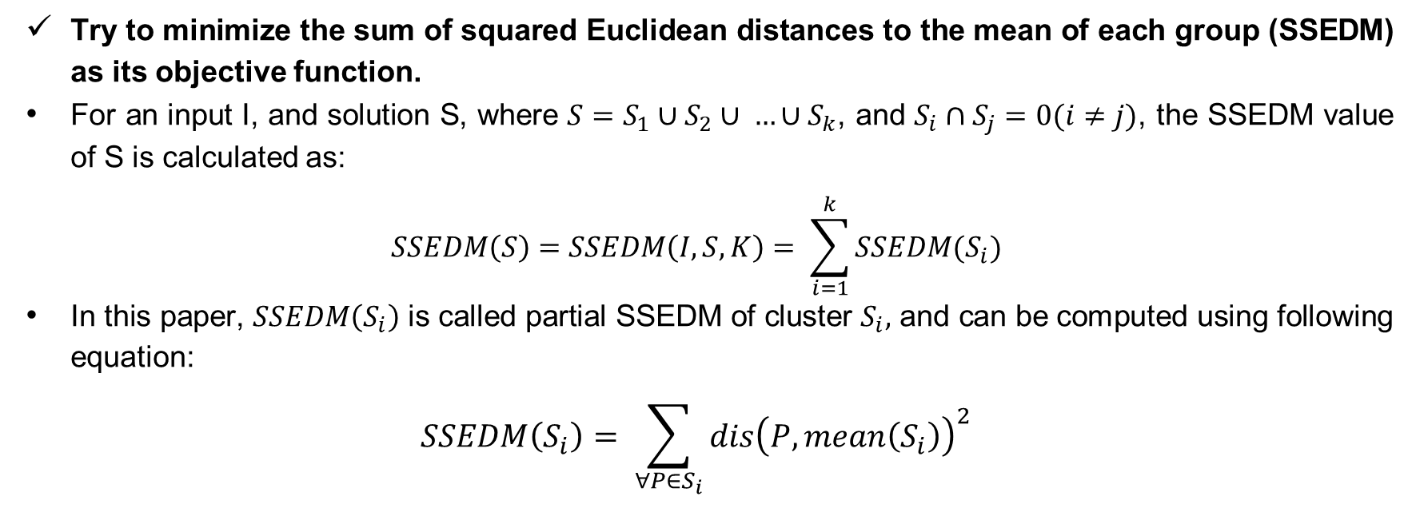
1. Introduction
K-means
Try to minimize the sum of squared Euclidean distances to the mean of each group (SSEDM) as its objective function.
For an input I, and solution S, where $S=S_{1}∪S_{2}∪ …∪S_{k}$, and $S_{i}∩S_{j}=0(i≠j)$, the SSEDM value of S is calculated as:
$$SSEDM\left(S\right)=SSEDM\left(I,S,K\right)= \sum_{i=1}^{k}{SSEDM(S_{i})}$$
In this paper, $SSEDM\left(S_{i}\right)$ is called partial SSEDM of cluster $S_{i},$ and can be computed using following equation:
$$SSEDM\left(S_{i}\right)= \sum_{∀P∈S_{i}}{dis{\left(P,mean\left(S_{i}\right)\right)}^{2}}$$
GLMs
EunJin Lee
2019-1 Multivariate Analysis
PJM WSM ISH

Slide 6

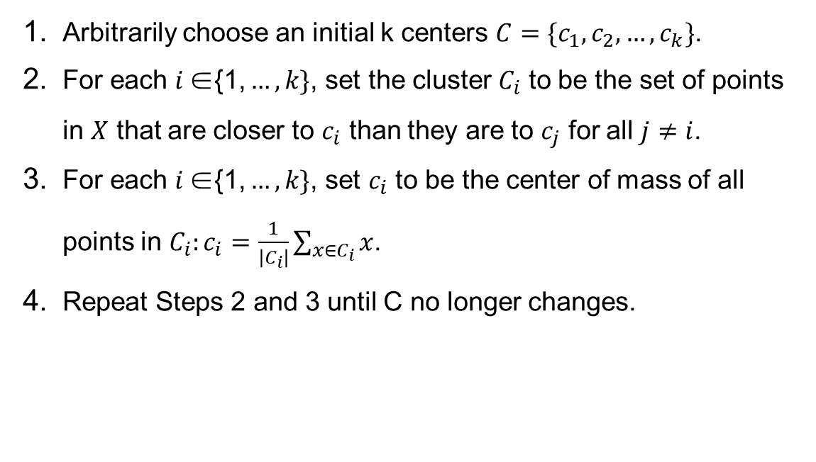
1. Introduction
K-means
Arbitrarily choose an initial k centers $C=\{c_{1}, c_{2}, …, c_{k}\}$.
For each $i \text{∈}\text{\{1,}…,k\}$, set the cluster $C_{i}$ to be the set of points in $X$ that are closer to $c_{i}$ than they are to $c_{j}$ for all $j≠i$.
For each $i \text{∈\{1,}…,k\}$, set $c_{i}$ to be the center of mass of all points in $C_{i}:c_{i}=\frac{1}{\left|C_{i}\right|}\sum_{x∈C_{i}}{x}$.
Repeat Steps 2 and 3 until C no longer changes.
GLMs
EunJin Lee
2019-1 Multivariate Analysis
PJM WSM ISH

Slide 7
1. Introduction
K-means
Although the k-means is an effective algorithm,
its performance strongly depends on the first instruction,
where the initial centers are selected.
Arbitrarily choose an initial k centers $C=\{c_{1}, c_{2}, …, c_{k}\}$.
For each $i \text{∈}\text{\{1,}…,k\}$, set the cluster $C_{i}$ to be the set of points in $X$ that are closer to $c_{i}$ than they are to $c_{j}$ for all $j≠i$.
For each $i \text{∈\{1,}…,k\}$, set $c_{i}$ to be the center of mass of all points in $C_{i}:c_{i}=\frac{1}{\left|C_{i}\right|}\sum_{x∈C_{i}}{x}$.
Repeat Steps 2 and 3 until C no longer changes.
GLMs
EunJin Lee
2019-1 Multivariate Analysis
PJM WSM ISH

Slide 8
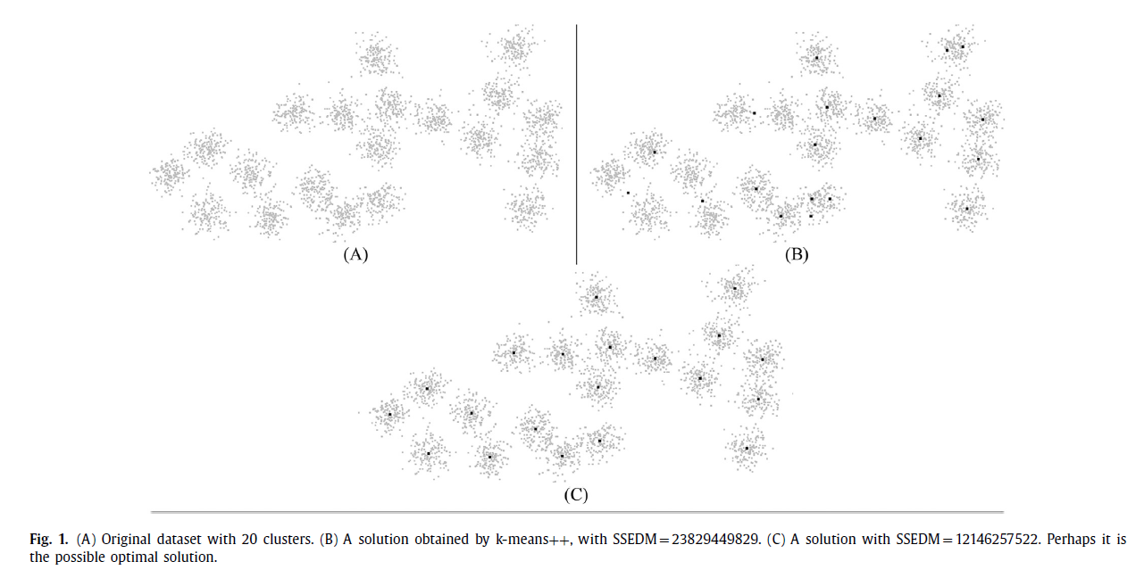
1. Introduction
GLMs
EunJin Lee
2019-1 Multivariate Analysis
PJM WSM ISH

Slide 9
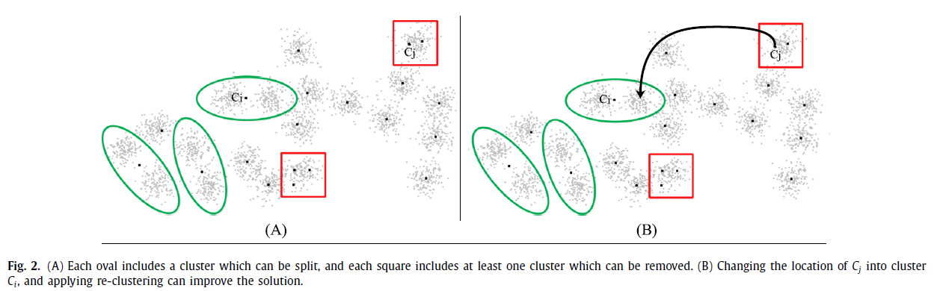
1. Introduction
GLMs
EunJin Lee
2019-1 Multivariate Analysis
PJM WSM ISH

Slide 10
2. Recent works for the k-means
As the k-means is too sensitive to initial centers, many research works try to propose an effective method to initialize centers of the k-means.
Clustering to minimize the maximum intercluster distance
A new initialization technique for generalized Lloyd iteration
A method for initializing the k-means clustering algorithm using kd-trees
K-means++: the advantages of careful seeding
A deterministic method for initializing k-means clustering(PCA-part)
The global k-means clustering algorithm(GKM)
The MinMax k-means clustering algorithm
GLMs
EunJin Lee
2019-1 Multivariate Analysis
PJM WSM ISH

Slide 11
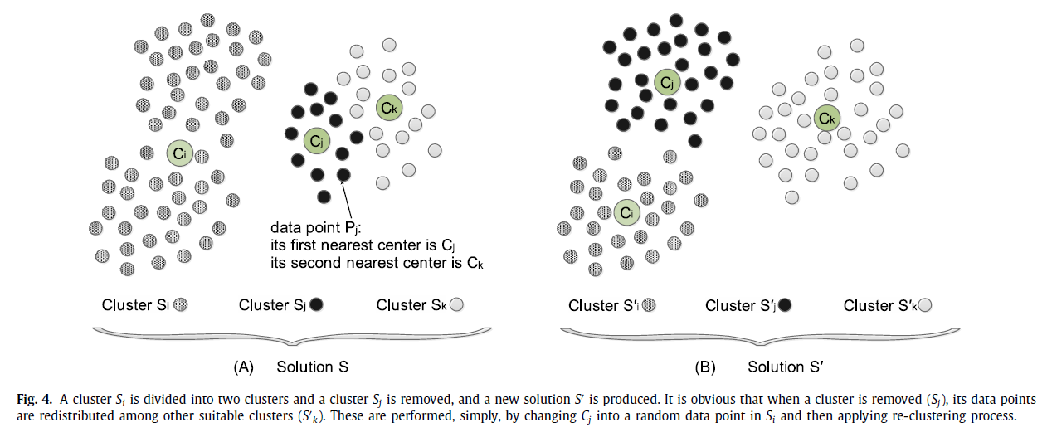
3. The I-k-means - +
The minus-plus can be done by changing the location of $C_{j}$ as same as a random point in $S_{i}$ and applying the k-means.
GLMs
EunJin Lee
2019-1 Multivariate Analysis
PJM WSM ISH

Slide 12
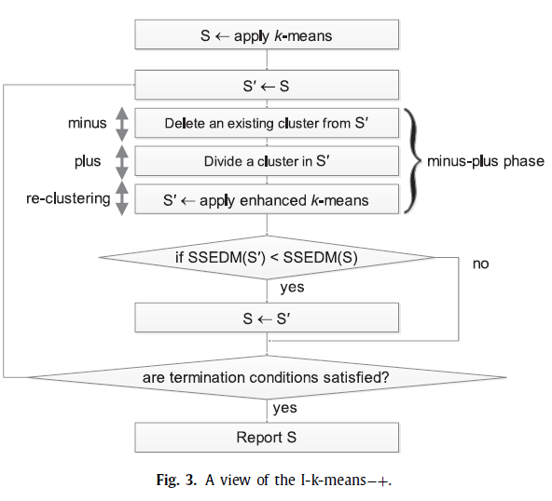
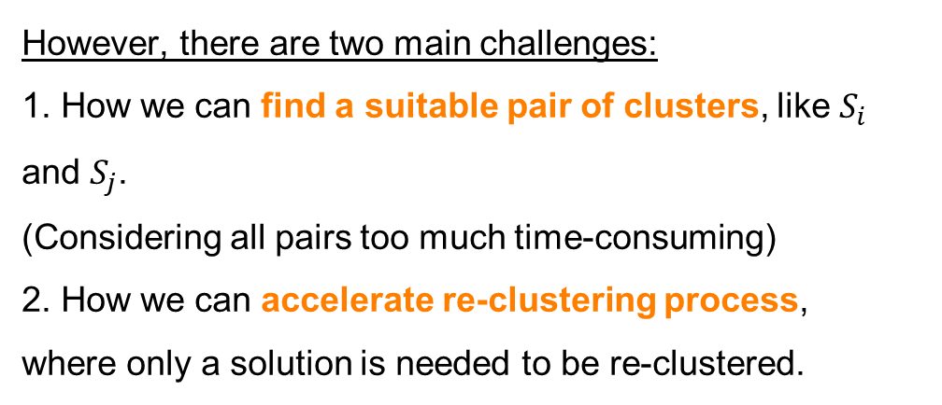
3. The I-k-means - +
However, there are two main challenges:
1. How we can find a suitable pair of clusters, like $S_{i}$ and $S_{j}$.
(Considering all pairs too much time-consuming)
2. How we can accelerate re-clustering process,
where only a solution is needed to be re-clustered.
1
2
GLMs
EunJin Lee
2019-1 Multivariate Analysis
PJM WSM ISH

Slide 13
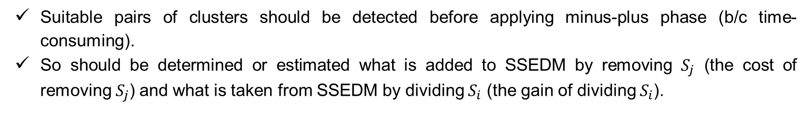
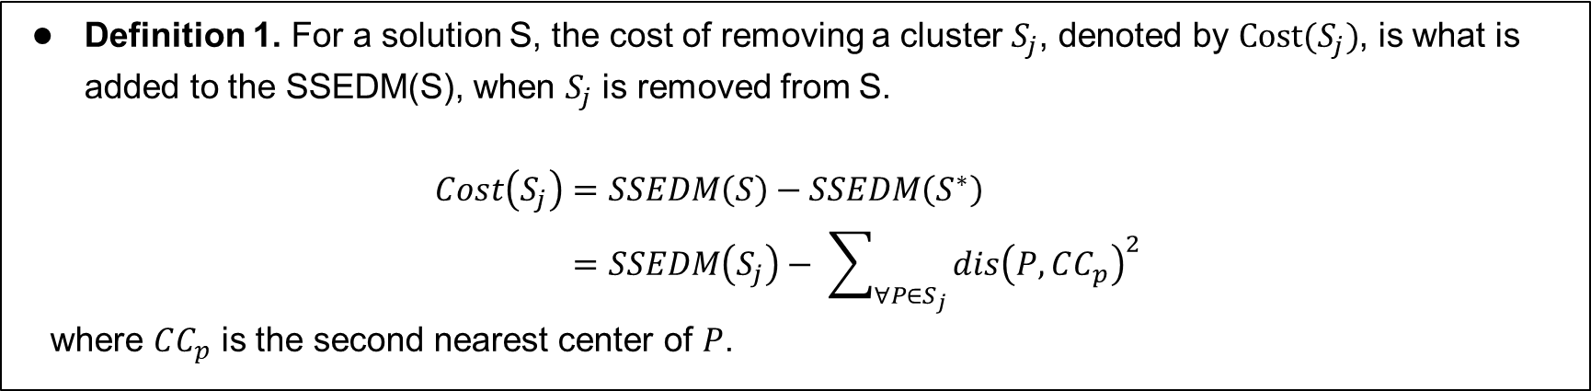
3. The I-k-means - +
3.1 Detecting suitable pairs
Suitable pairs of clusters should be detected before applying minus-plus phase (b/c time-consuming).
So should be determined or estimated what is added to SSEDM by removing $S_{j}$ (the cost of removing $S_{j}$) and what is taken from SSEDM by dividing $S_{i}$ (the gain of dividing $S_{i}$).
Definition 1. For a solution S, the cost of removing a cluster $S_{j}$, denoted by $Cost(S_{j})$, is what is added to the SSEDM(S), when $S_{j}$ is removed from S.
$$Cost\left(S_{j}\right)=SSEDM\left(S\right)−SSEDM\left(S^{∗}\right) \\ =SSEDM\left(S_{j}\right)− \sum_{∀P∈S_{j}}{dis{\left(P,CC_{p}\right)}^{2}}$$
where $CC_{p}$ is the second nearest center of $P$.
GLMs
EunJin Lee
2019-1 Multivariate Analysis
PJM WSM ISH

Slide 14
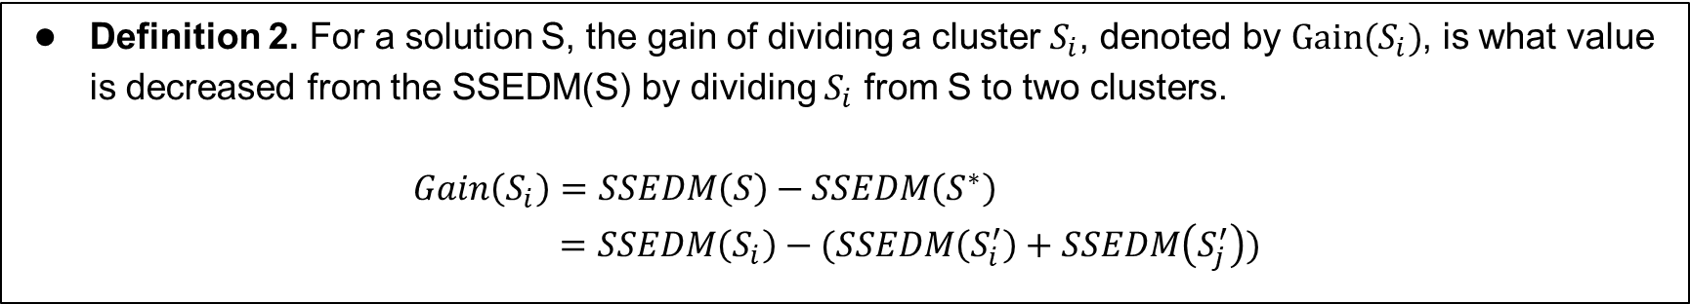
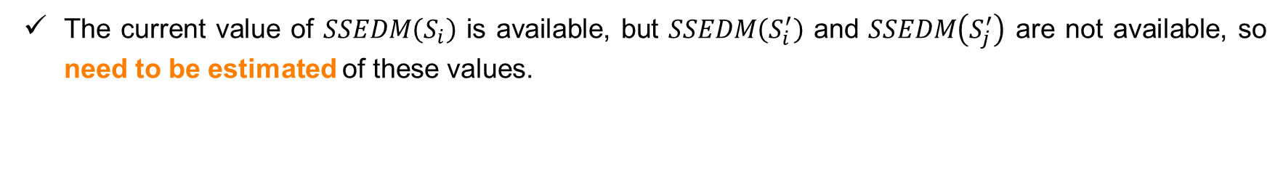
3. The I-k-means - +
3.1 Detecting suitable pairs
Definition 2. For a solution S, the gain of dividing a cluster $S_{i}$, denoted by $Gain(S_{i})$, is what value is decreased from the SSEDM(S) by dividing $S_{i}$ from S to two clusters.
$$Gain\left(S_{i}\right)=SSEDM\left(S\right)−SSEDM\left(S^{∗}\right) \\ =SSEDM\left(S_{i}\right)−(SSEDM\left(S_{i}^{′}\right)+SSEDM\left(S_{j}^{′}\right))$$
The current value of $SSEDM\left(S_{i}\right)$ is available, but $SSEDM\left(S_{i}^{′}\right)$ and $SSEDM\left(S_{j}^{′}\right)$ are not available, so need to be estimated of these values.
GLMs
EunJin Lee
2019-1 Multivariate Analysis
PJM WSM ISH

Slide 15
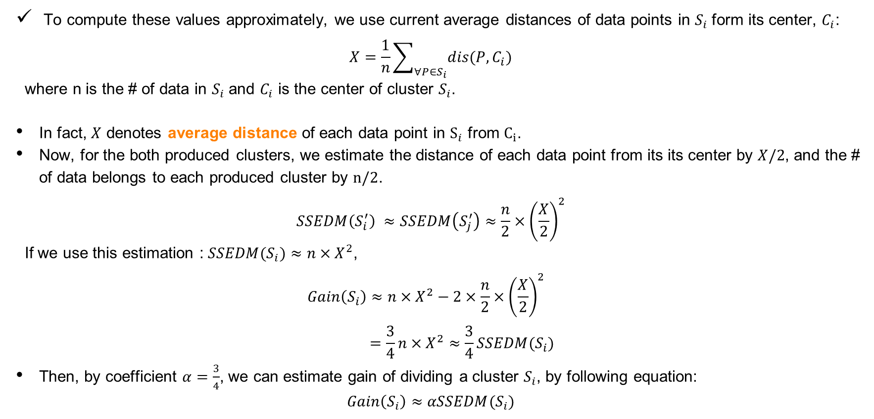
3. The I-k-means - +
3.1 Detecting suitable pairs
To compute these values approximately, we use current average distances of data points in $S_{i}$ form its center, $C_{i}$:
$$X=\frac{1}{n}\sum_{∀P∈S_{i}}{dis(P,C_{i})}$$
where n is the # of data in $S_{i}$ and $C_{i}$ is the center of cluster $S_{i}$.
In fact, $X$ denotes average distance of each data point in $S_{i}$ from $C_{i}$.
Now, for the both produced clusters, we estimate the distance of each data point from its its center by $X/2$, and the # of data belongs to each produced cluster by $n/2$.
$$SSEDM\left(S_{i}^{′}\right) ≈SSEDM\left(S_{j}^{′}\right)≈\frac{n}{2}×{\left(\frac{X}{2}\right)}^{2}$$
If we use this estimation : $SSEDM(S_{i})≈n×X^{2}$,
$$Gain\left(S_{i}\right)≈n×X^{2}−2×\frac{n}{2}×{\left(\frac{X}{2}\right)}^{2} \\ =\frac{3}{4}n×X^{2}≈\frac{3}{4}SSEDM(S_{i})$$
Then, by coefficient $α=\frac{3}{4}$, we can estimate gain of dividing a cluster $S_{i}$, by following equation:
$$Gain\left(S_{i}\right)≈αSSEDM(S_{i})$$
GLMs
EunJin Lee
2019-1 Multivariate Analysis
PJM WSM ISH

Slide 16
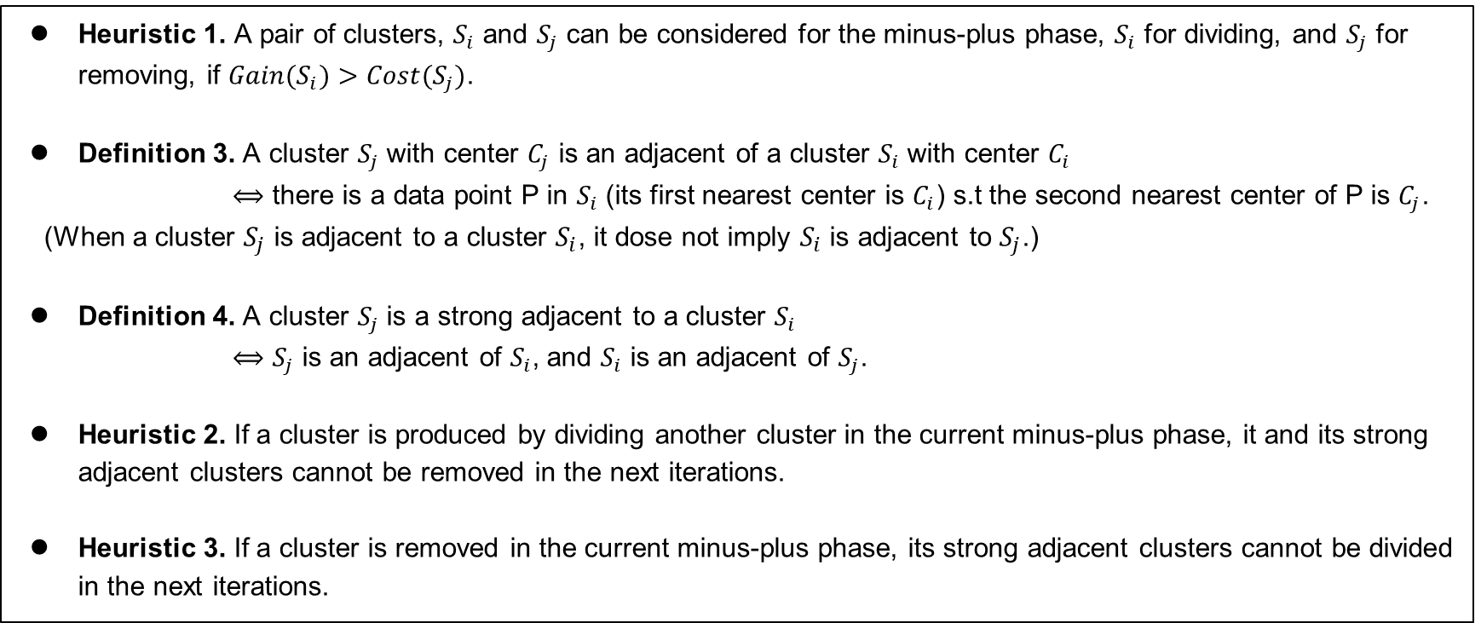
3. The I-k-means - +
3.1 Detecting suitable pairs
Heuristic 1. A pair of clusters, $S_{i}$ and $S_{j}$ can be considered for the minus-plus phase, $S_{i}$ for dividing, and $S_{j}$ for removing, if ${Gain(S}_{i})>Cost(S_{j})$.
Definition 3. A cluster $S_{j}$ with center $C_{j}$ is an adjacent of a cluster $S_{i}$ with center $C_{i}$
$⟺$ there is a data point P in $S_{i}$ (its first nearest center is $C_{i}$) s.t the second nearest center of P is $C_{j}$.
(When a cluster $S_{j}$ is adjacent to a cluster $S_{i}$, it dose not imply $S_{i}$ is adjacent to $S_{j}$.)
Definition 4. A cluster $S_{j}$ is a strong adjacent to a cluster $S_{i}$
$⟺$ $S_{j}$ is an adjacent of $S_{i}$, and $S_{i}$ is an adjacent of $S_{j}$.
Heuristic 2. If a cluster is produced by dividing another cluster in the current minus-plus phase, it and its strong adjacent clusters cannot be removed in the next iterations.
Heuristic 3. If a cluster is removed in the current minus-plus phase, its strong adjacent clusters cannot be divided in the next iterations.
GLMs
EunJin Lee
2019-1 Multivariate Analysis
PJM WSM ISH

Slide 17
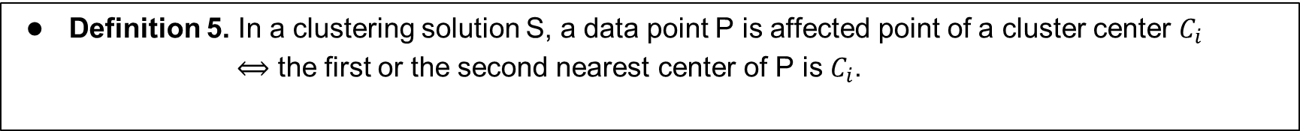
3. The I-k-means - +
3.2 The topical $k$-means(t-k-means)
So as global re-clustering of the instance is time-consuming, the t-k-means is only applied topically.
The t-k-means accelerate the re-clustering process by considering affected points and ignoring unaffected points.
Definition 5. In a clustering solution S, a data point P is affected point of a cluster center $C_{i}$
$⟺$ the first or the second nearest center of P is $C_{i}$.
GLMs
EunJin Lee
2019-1 Multivariate Analysis
PJM WSM ISH

Slide 18
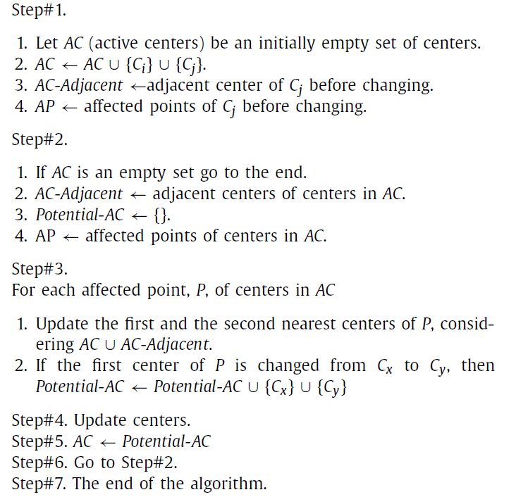
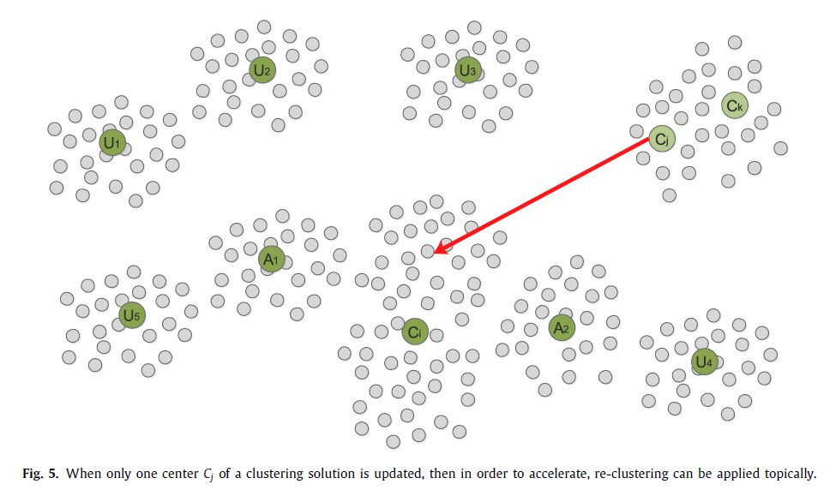
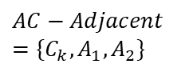
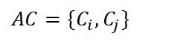
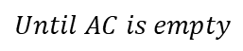
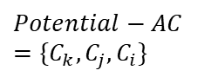
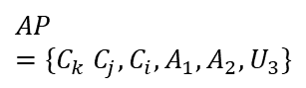
3. The I-k-means - +
3.2 The topical $k$-means(t-k-means)
The following instructions show t-k-means which are applied to a solution in which only the center $C_{j}$ of a cluster $S_{j}$ is changed as a random point in $S_{i}$ with the center $C_{i}$.
$$AC=\{C_{i}, C_{j}\}$$
$$AC−Adjacent=\{C_{k}, A_{1}, A_{2}\}$$
$$AP=\{C_{k} C_{j},C_{i},A_{1},A_{2},U_{3}\}$$
$$Potential−AC=\{{C_{k},C_{j},C}_{i}\}$$
$$Until AC is empty$$
GLMs
EunJin Lee
2019-1 Multivariate Analysis
PJM WSM ISH

Slide 19
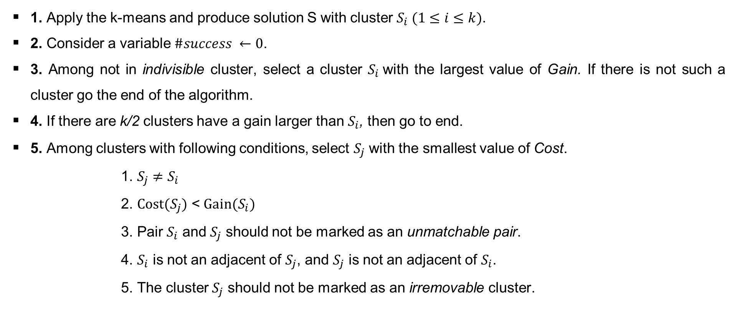
3. The I-k-means - +
3.3 The I-k-means -+ via detailed instructions
1. Apply the k-means and produce solution S with cluster $S_{i} (1≤i≤k)$.
2. Consider a variable $\#success ←0$.
3. Among not in indivisible cluster, select a cluster $S_{i}$with the largest value of Gain. If there is not such a cluster go the end of the algorithm.
4. If there are k/2 clusters have a gain larger than $S_{i}$, then go to end.
5. Among clusters with following conditions, select $S_{j}$ with the smallest value of Cost.
1. $S_{j}≠S_{i}$
2. $Cost(S_{j})$ < $Gain(S_{i})$
3. Pair $S_{i}$ and $S_{j}$ should not be marked as an unmatchable pair.
4. $S_{i}$ is not an adjacent of $S_{j}$, and $S_{j}$ is not an adjacent of $S_{i}$.
5. The cluster $S_{j}$ should not be marked as an irremovable cluster.
GLMs
EunJin Lee
2019-1 Multivariate Analysis
PJM WSM ISH

Slide 20
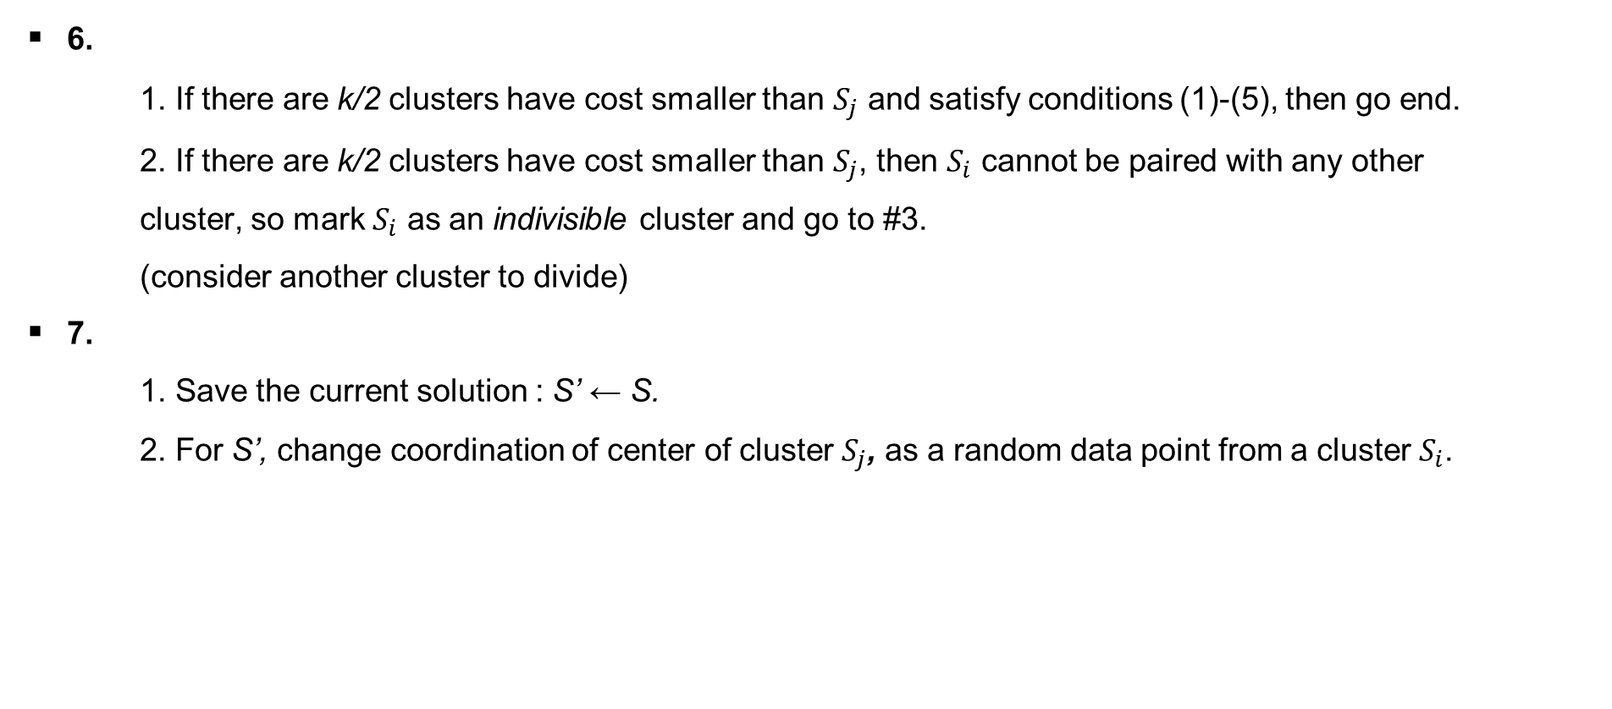
3. The I-k-means - +
3.3 The I-k-means -+ via detailed instructions
6.
1. If there are k/2 clusters have cost smaller than $S_{j}$ and satisfy conditions (1)-(5), then go end.
2. If there are k/2 clusters have cost smaller than $S_{j}$, then $S_{i}$ cannot be paired with any other cluster, so mark $S_{i}$ as an indivisible cluster and go to #3.
(consider another cluster to divide)
7.
1. Save the current solution : S’ ← S.
2. For S’, change coordination of center of cluster $S_{j}$, as a random data point from a cluster $S_{i}$.
GLMs
EunJin Lee
2019-1 Multivariate Analysis
PJM WSM ISH

Slide 21
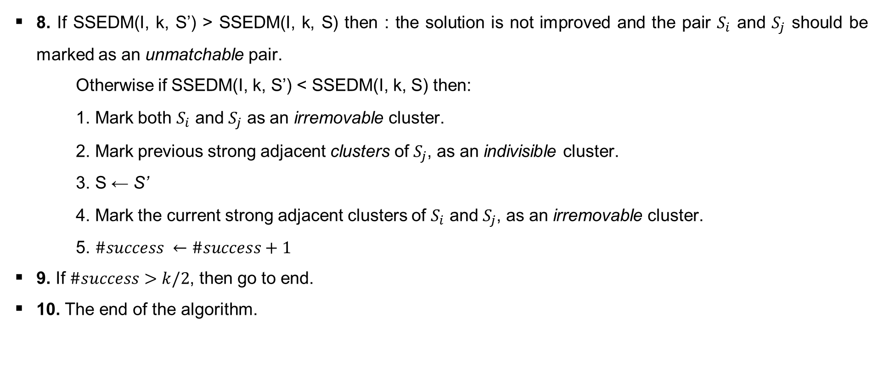
3. The I-k-means - +
3.3 The I-k-means -+ via detailed instructions
8. If SSEDM(I, k, S’) > SSEDM(I, k, S) then : the solution is not improved and the pair $S_{i}$ and $S_{j}$ should be marked as an unmatchable pair.
Otherwise if SSEDM(I, k, S’) < SSEDM(I, k, S) then:
1. Mark both $S_{i}$ and $S_{j}$ as an irremovable cluster.
2. Mark previous strong adjacent clusters of $S_{j}$, as an indivisible cluster.
3. S ← S’
4. Mark the current strong adjacent clusters of $S_{i}$ and $S_{j}$, as an irremovable cluster.
5. $\#success ←\#success+1$
9. If $\#success>k/2$, then go to end.
10. The end of the algorithm.
GLMs
EunJin Lee
2019-1 Multivariate Analysis
PJM WSM ISH

Slide 22
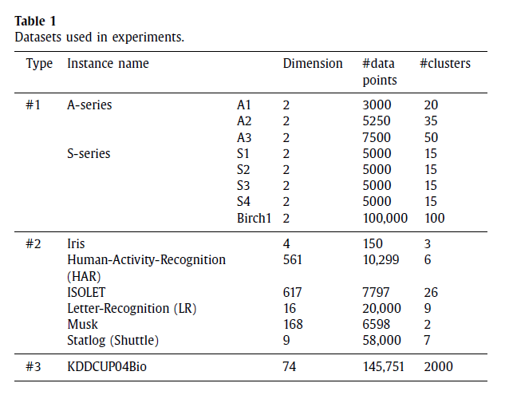
4. Results of performed experiments
Data from : two-dimensional synthetic problems, UCI machine learning repository, protein dataset(KDDCUP04Bio).
Compare I-k-means-+ to : k-means, k-means++.
Criteria for accuracy : SSEDM, runtime of algorithms, maximum of partial SSEDMs.
GLMs
EunJin Lee
2019-1 Multivariate Analysis
PJM WSM ISH

Slide 23
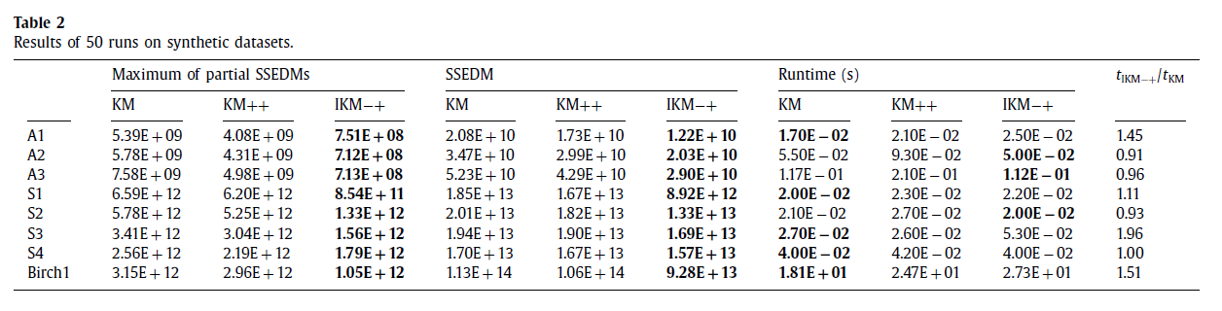
4. Results of performed experiments
1) Results on synthetic datasets
GLMs
EunJin Lee
2019-1 Multivariate Analysis
PJM WSM ISH

Slide 24
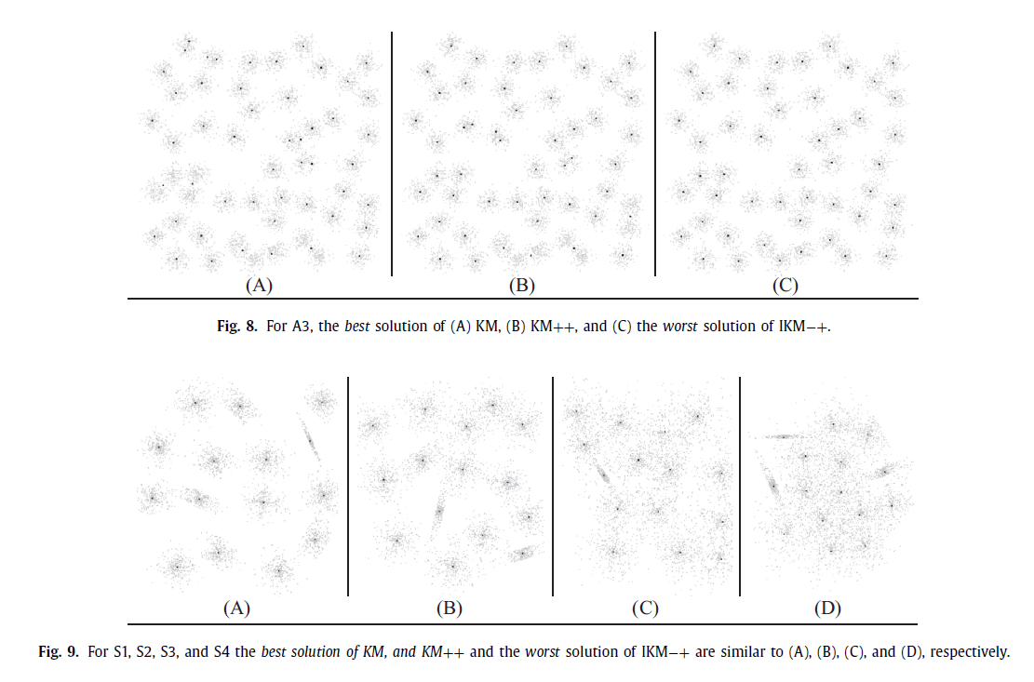
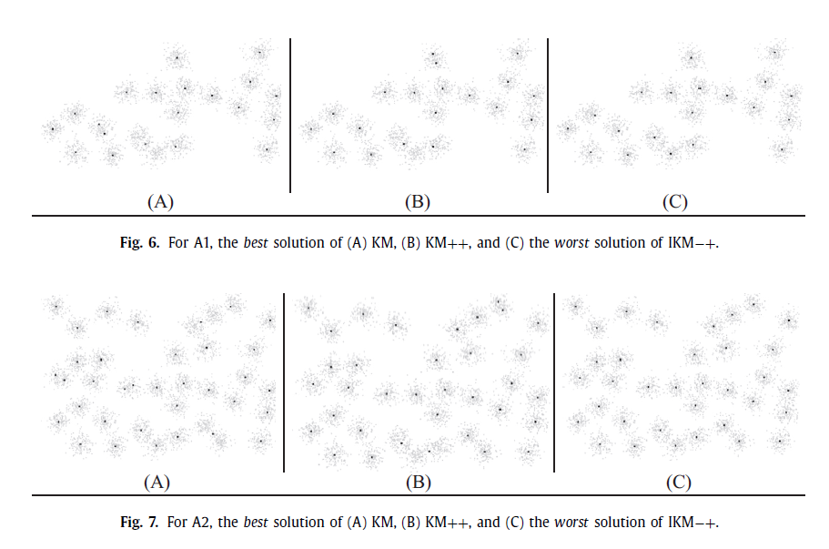
4. Results of performed experiments
1) Results on synthetic datasets
GLMs
EunJin Lee
2019-1 Multivariate Analysis
PJM WSM ISH

Slide 25
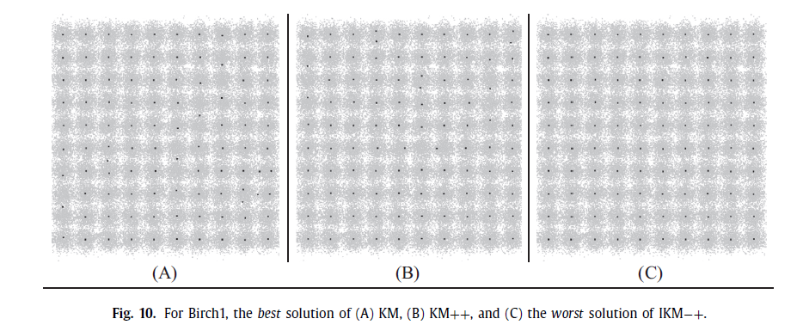
4. Results of performed experiments
1) Results on synthetic datasets
The worst solution obtained by IKM-+ is better than the best solutions of other two competitors.
GLMs
EunJin Lee
2019-1 Multivariate Analysis
PJM WSM ISH

Slide 26
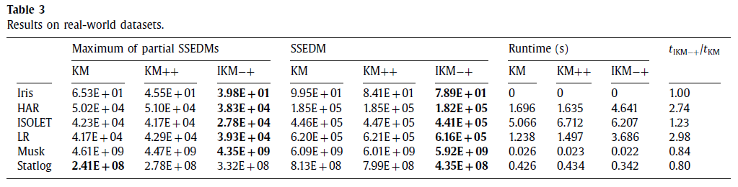
4. Results of performed experiments
2) Results on real-world datasets
GLMs
EunJin Lee
2019-1 Multivariate Analysis
PJM WSM ISH

Slide 27
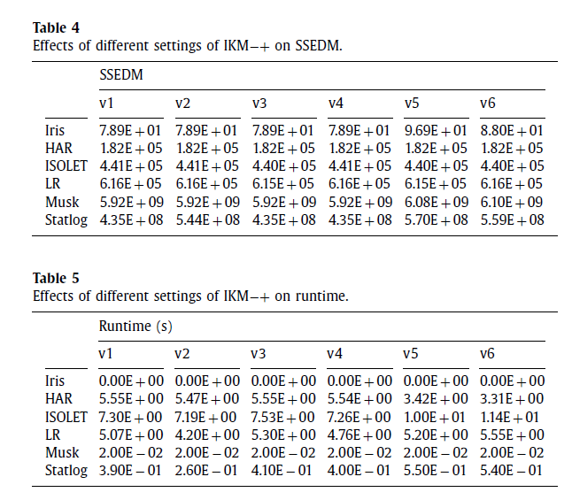
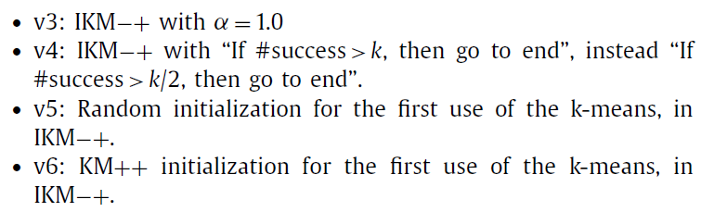
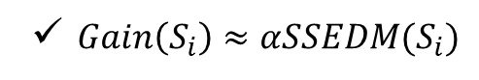
4. Results of performed experiments
3) Effects of $α$ and number of improvements on IKM-+
$Gain\left(S_{i}\right)≈αSSEDM(S_{i})$
GLMs
EunJin Lee
2019-1 Multivariate Analysis
PJM WSM ISH

Slide 28
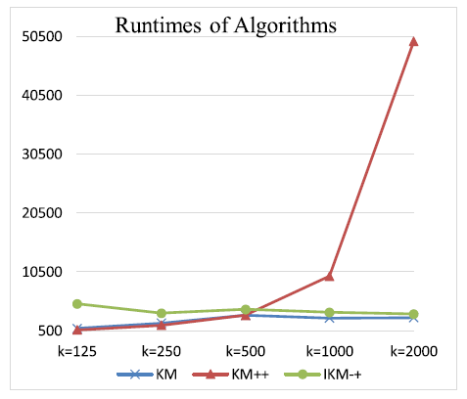
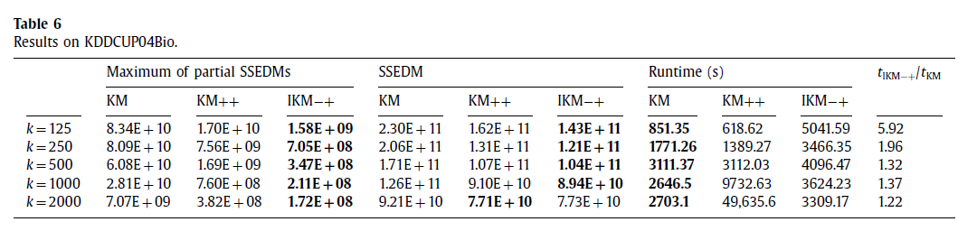
4. Results of performed experiments
4) Results on the third type dataset
GLMs
EunJin Lee
2019-1 Multivariate Analysis
PJM WSM ISH

Slide 29
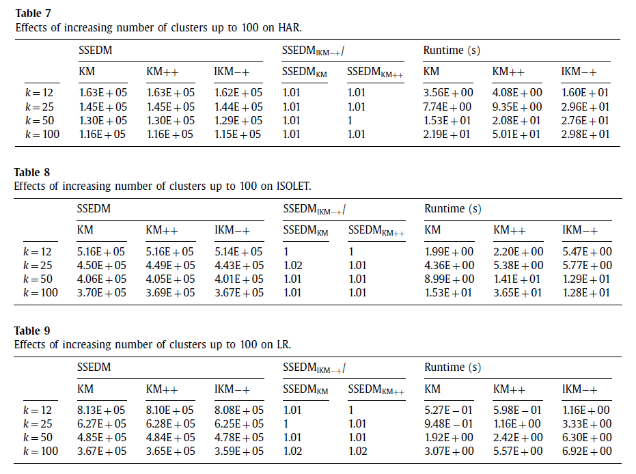
4. Results of performed experiments
5) More experiments to consider effects of increasing number of clusters
GLMs
EunJin Lee
2019-1 Multivariate Analysis
PJM WSM ISH

Slide 30
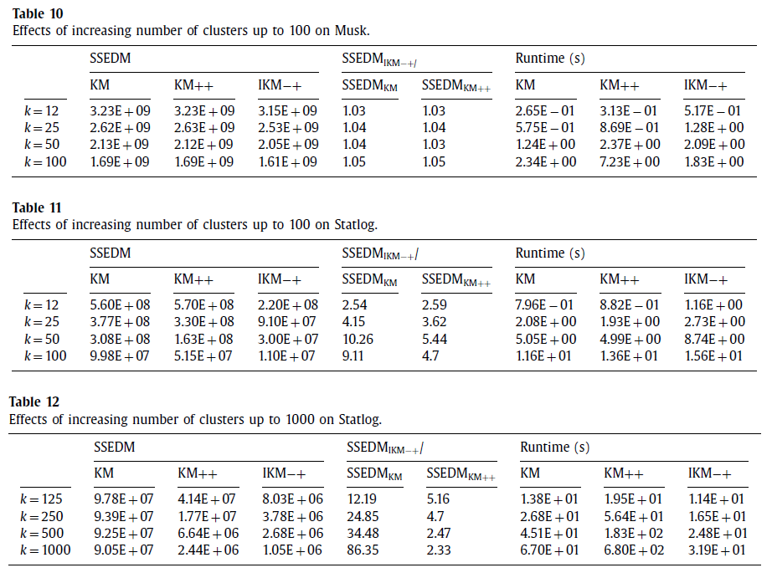
4. Results of performed experiments
5) More experiments to consider effects of increasing number of clusters
GLMs
EunJin Lee
2019-1 Multivariate Analysis
PJM WSM ISH

Slide 31
5. Conclusion
IKM-+ improve k-means by removing one(minus), dividing another one(plus).
Although this process seems to be time-consuming, using some heuristics effectively speeds up the IKM-+, where, for the largest data set with the largest clusters, runtime ↓, accuracy ↑ than KM, KM++.
Advantages of IKM-+ reveal more when it is applied to instances with a large number of data points or a large number of clusters.
Be expected to similar algorithms like FCM with similar objective function, and similar steps to the k-means in its algorithm.
GLMs
EunJin Lee
2019-1 Multivariate Analysis
PJM WSM ISH

